Slide 1




Data-Driven Pricing Strategy for Big Mountain Resort

Slide 2
Problem Identification
Introduction:
Briefly introduce Big Mountain Resort and its current situation.
Highlight the need for optimizing ticket pricing to maximize revenue and maintain competitiveness.
Current Challenges:
Current ticket prices may not fully reflect the value of the facilities offered.
Addition of a new chair lift introduces further operational costs.
Need for a data-driven approach to determine optimal pricing.

Slide 3
Problem Identification (Continued)
Data Limitations:
Dataset only included ticket prices and additional operating cost of the new chair lift.
Other cost information such as maintenance, staffing, and operational costs were not included.
Importance of comprehensive data for accurate analysis.

Slide 4
Recommendation and Key Findings
Recommendation:
Increase ticket prices to better reflect the value of the facilities and cover additional operating costs.
Develop an interactive tool for business analysts to explore different pricing scenarios independently.
Key Findings:
Higher ticket prices can be supported by the market.
Data-driven approach ensures competitiveness and visitor satisfaction.
Continuous monitoring and adjustments are essential for long-term success.

Slide 5
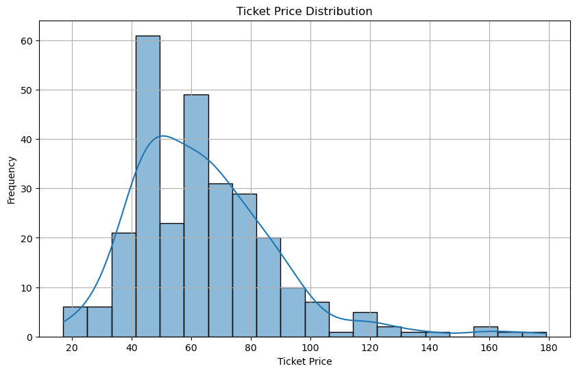
Modeling Results and Analysis
Exploratory Data Analysis:
Distribution of ticket prices.
Key insights from the data.
Visualizations (e.g., histograms, box plots).

Slide 6
Modeling Results and Analysis (Continued)
Model Preprocessing and Feature Engineering:
Creation of new features to improve predictive power.
Consideration of average cost per visitor and external factors.

Slide 7
Modeling Results and Analysis (Continued)
Algorithms and Evaluation:
Algorithms tested: linear regression, decision trees, random forests.
Evaluation metrics: Mean Absolute Error (MAE), Root Mean Squared Error (RMSE).
Winning model: Random forest with the most accurate predictions.

Slide 8
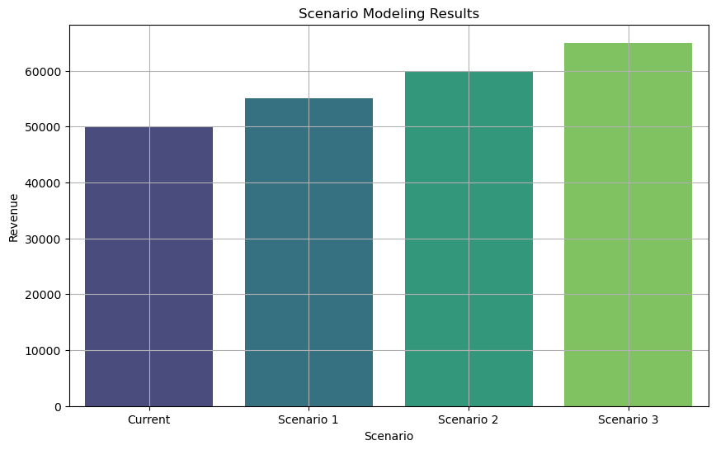
Modeling Results and Analysis (Continued)
Scenario Modeling:
Simulation of various pricing scenarios.
Identification of optimal pricing strategy.
Visualizations of scenario modeling results.

Slide 9
Summary and Conclusion
Summary:
Data-driven approach to optimize ticket pricing.
Higher ticket prices supported by market analysis.
Importance of comprehensive data and continuous monitoring.
Conclusion:
Implement recommended pricing strategy.
Develop tools for business analysts to explore scenarios.
Focus on long-term growth and visitor satisfaction.

